Slide 1
Thinking about Data?
https://think.cs.vt.edu/corgis
The Collection Of Really Great, Interesting, Situated Datasets

Slide 2
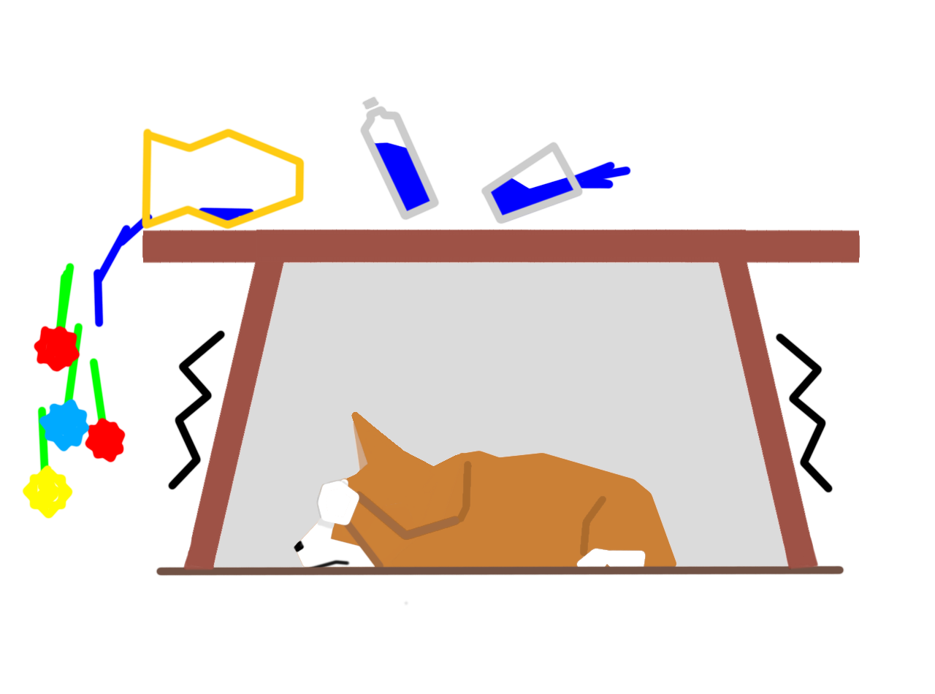
CORGIS Dataset #15
Earthquakes
Daily records of earthquake incidents around the world.
Find this dataset and more at https://think.cs.vt.edu/corgis

Slide 3

CORGIS Dataset #5
Theater
Weekly records of major Broadway theater sales and attendance.
Find this dataset and more at https://think.cs.vt.edu/corgis

Slide 4

CORGIS Dataset #27
Immigration
Yearly records about the immigration of foreign nations to the United States.
Find this dataset and more at https://think.cs.vt.edu/corgis

Slide 5

CORGIS Dataset #3
Airports
Information about flights and delays in major United States airports.
Find this dataset and more at https://think.cs.vt.edu/corgis

Slide 6

CORGIS Dataset #8
Books
Records and computed statistics about the top 1000 books on Project Gutenberg.
Find this dataset and more at https://think.cs.vt.edu/corgis

Slide 7

CORGIS Dataset #10
Construction
Monthly estimates of construction work costs done in the United States.
Find this dataset and more at https://think.cs.vt.edu/corgis

Slide 8
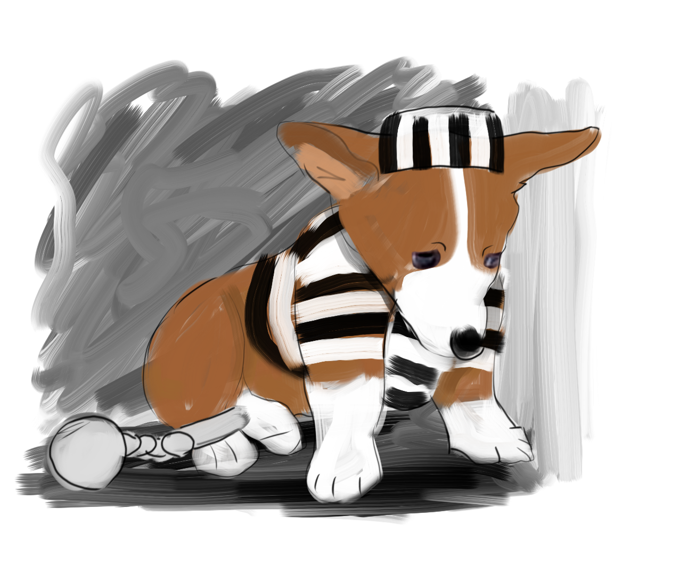
CORGIS Dataset #38
Crime
Yearly violent and property crime reports for the United States over many decades.
Find this dataset and more at https://think.cs.vt.edu/corgis

Slide 9

CORGIS Dataset #32
Publishers
E-book sales on Amazon, including daily and total earnings for 54,000 titles.
Find this dataset and more at https://think.cs.vt.edu/corgis

Slide 10

CORGIS Dataset #43
Artwork
Metadata about paintings, drawings, sculptures and more at the Tate art gallery.
Find this dataset and more at https://think.cs.vt.edu/corgis

Slide 11

CORGIS Dataset #44
Weather
Local United States weather reports, including temperature, precipitation, and wind.
Find this dataset and more at https://think.cs.vt.edu/corgis

Slide 12
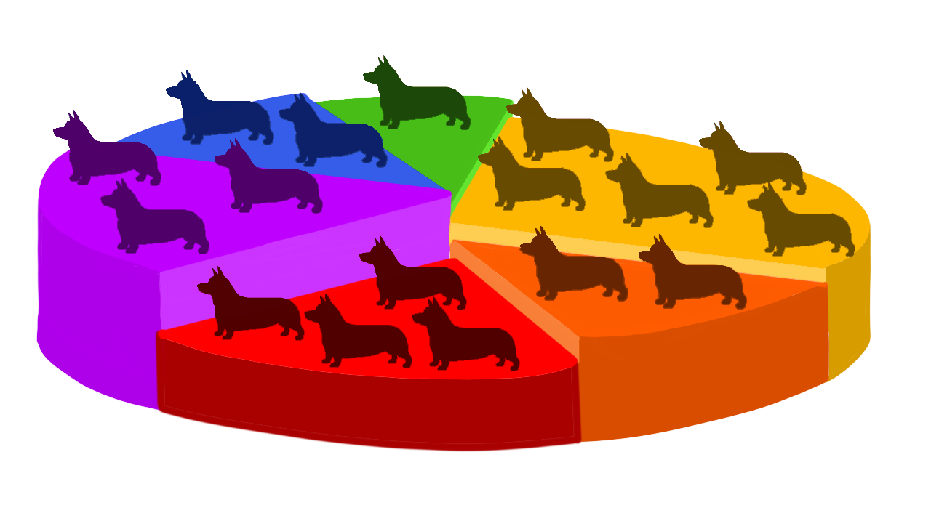
CORGIS Dataset #39
Demographics
Census data for the United States, including population, employment, and education.
Find this dataset and more at https://think.cs.vt.edu/corgis

Slide 13

CORGIS Dataset #35
Education
Yearly SAT Scores for students across the United States.
Find this dataset and more at https://think.cs.vt.edu/corgis

Slide 14

CORGIS Dataset #22
Global Development
Annual reports on urban/rural development, health, and infrastructure around the world
Find this dataset and more at https://think.cs.vt.edu/corgis

